Slide 1
CNN模型判別肺炎X光影像Web系統 寒假demo
Flask User Account and Profile Picture
資工四A 沈明楷
https://www.youtube.com/watch?v=pS3_VMSKwec

Slide 2
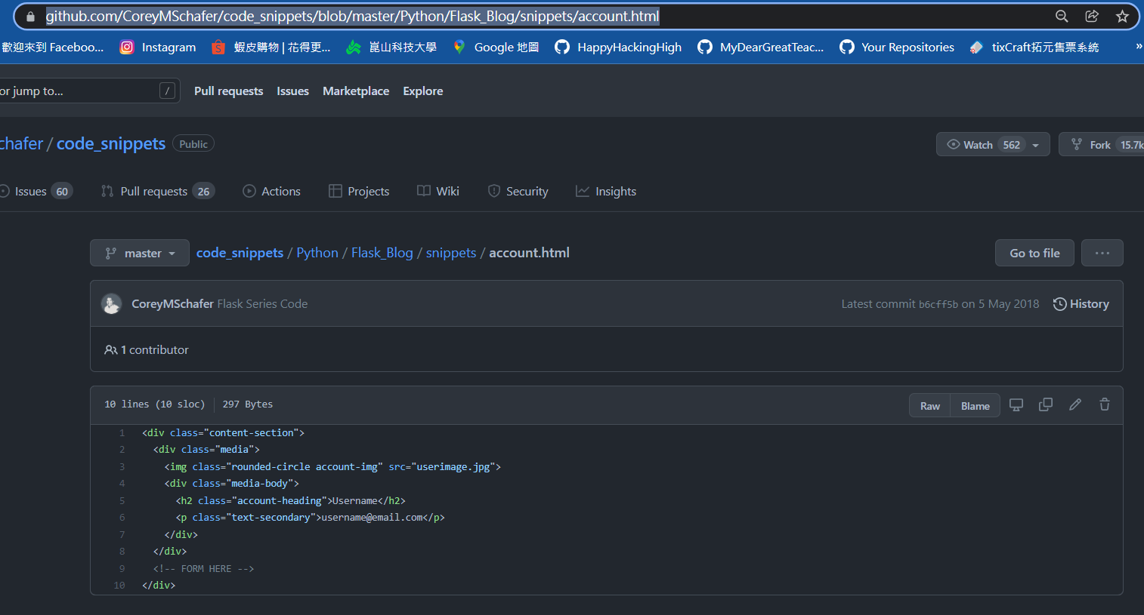
到以下網頁複製程式碼
https://github.com/CoreyMSchafer/code_snippets/blob/master/Python/Flask_Blog/snippets/account.html

Slide 3
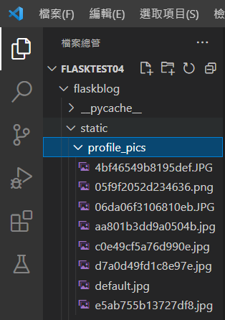
需新增profile_pics資料夾

Slide 4
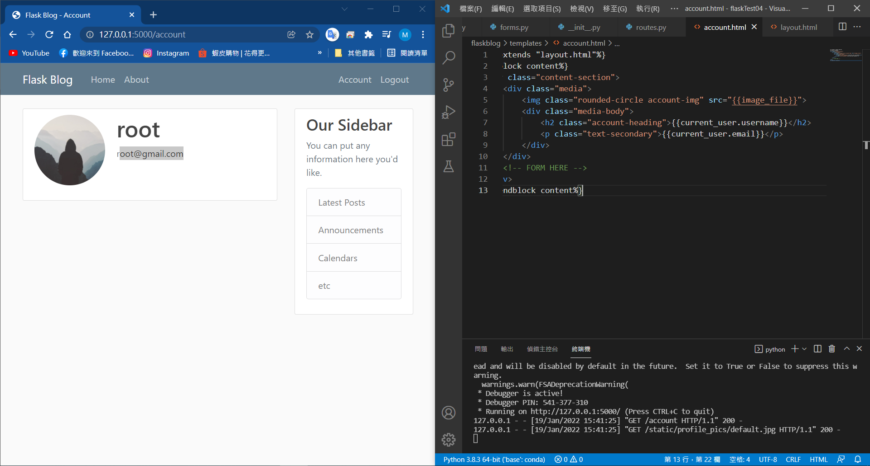

Slide 5
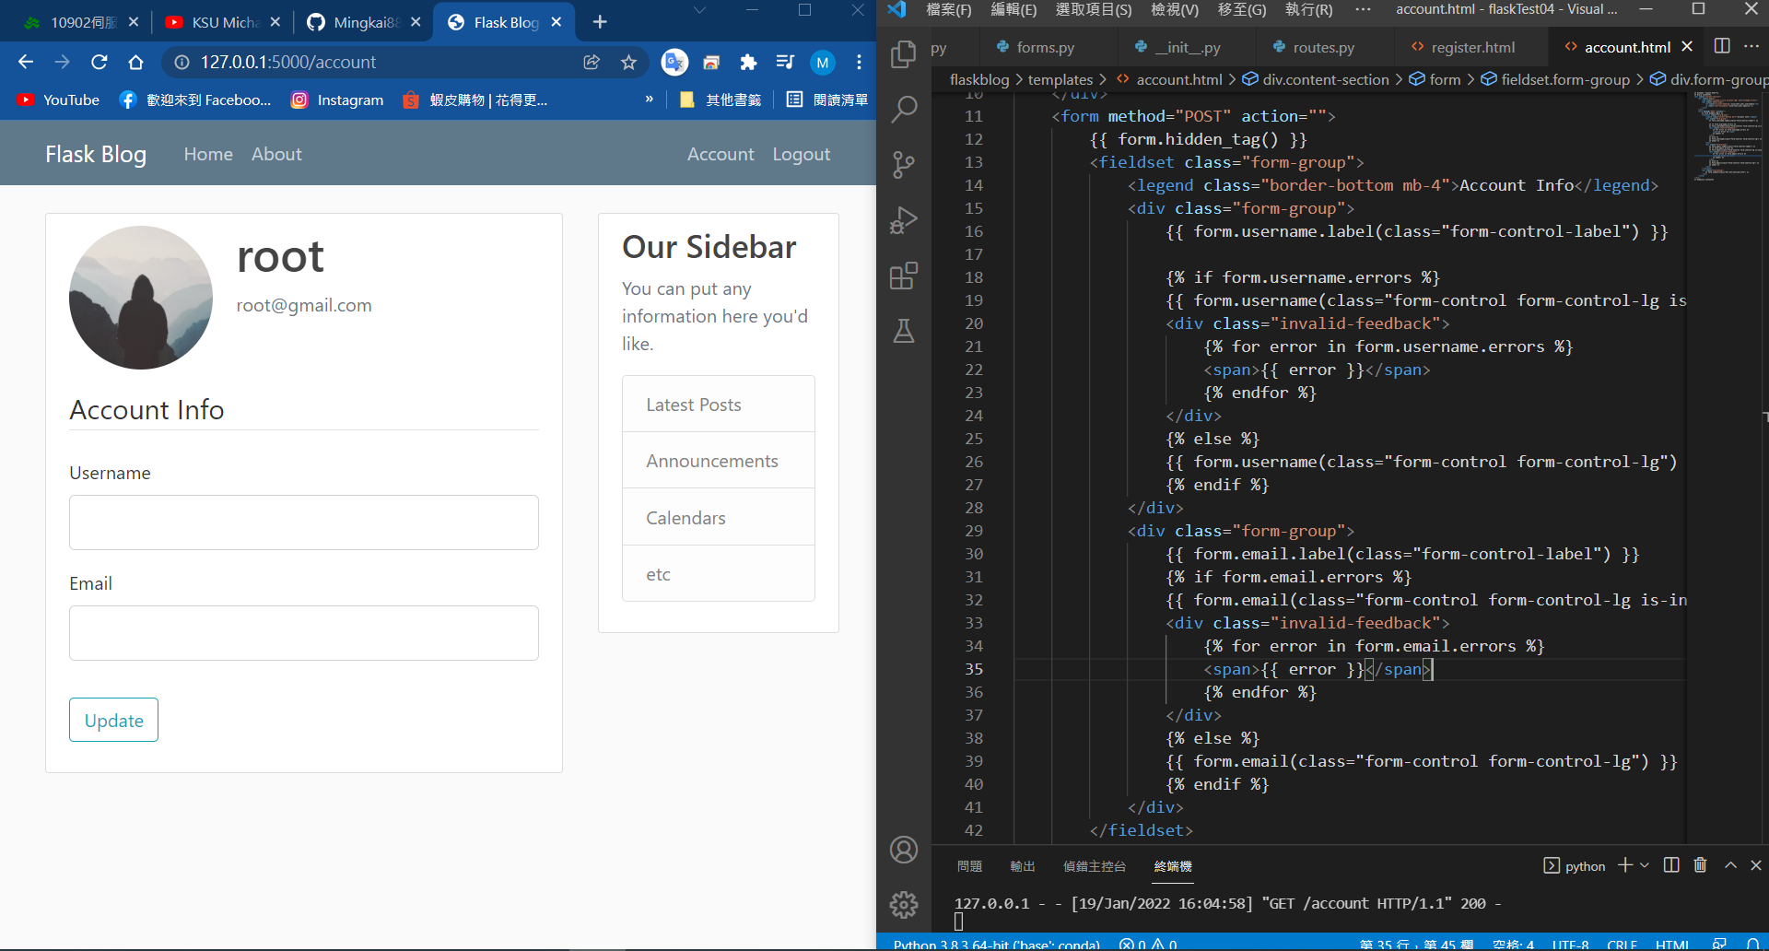

Slide 6
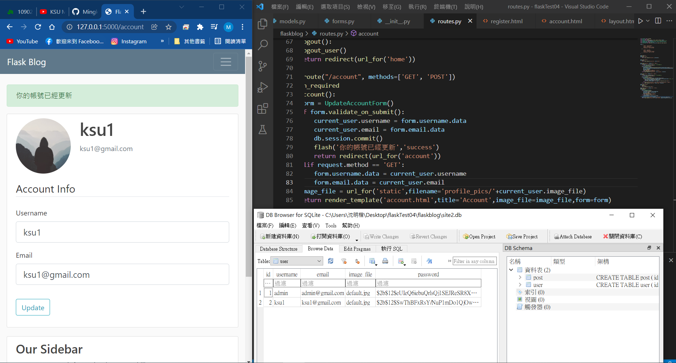
Update account

Slide 7
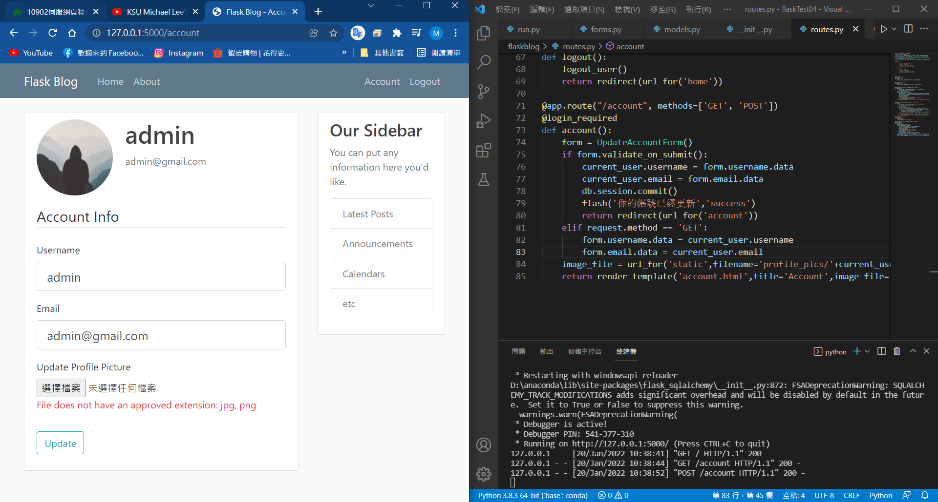
Update Profile Picture(只能上傳附檔名.jpg .png類型)

Slide 8
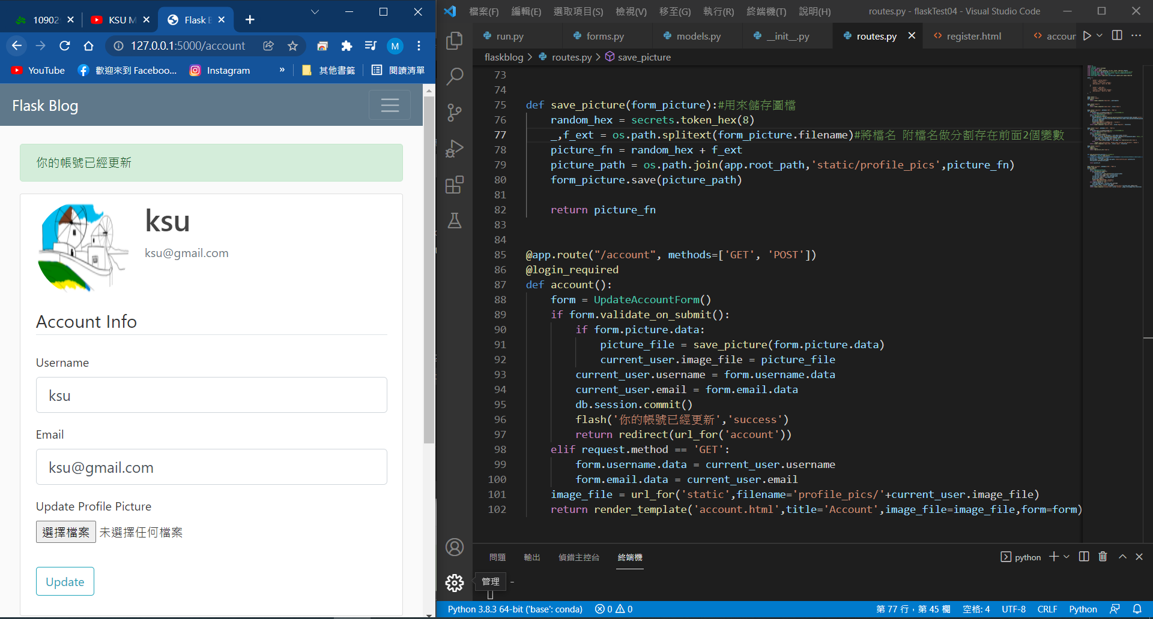
Update Profile Picture(已更新)

Slide 9
下載Pillow套件

Slide 10
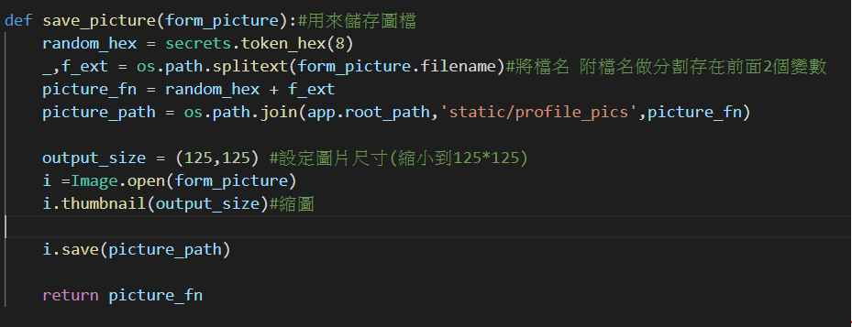
將上傳圖片壓縮成125*125

Slide 11
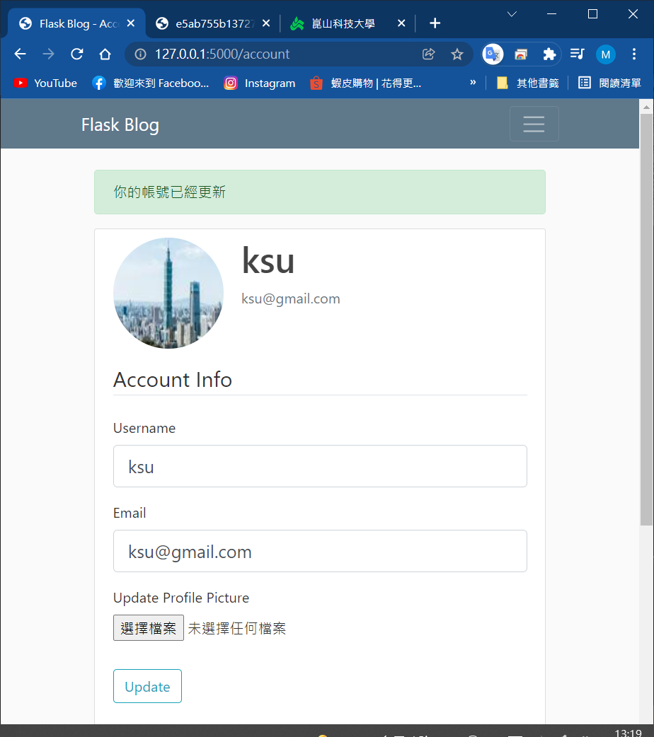
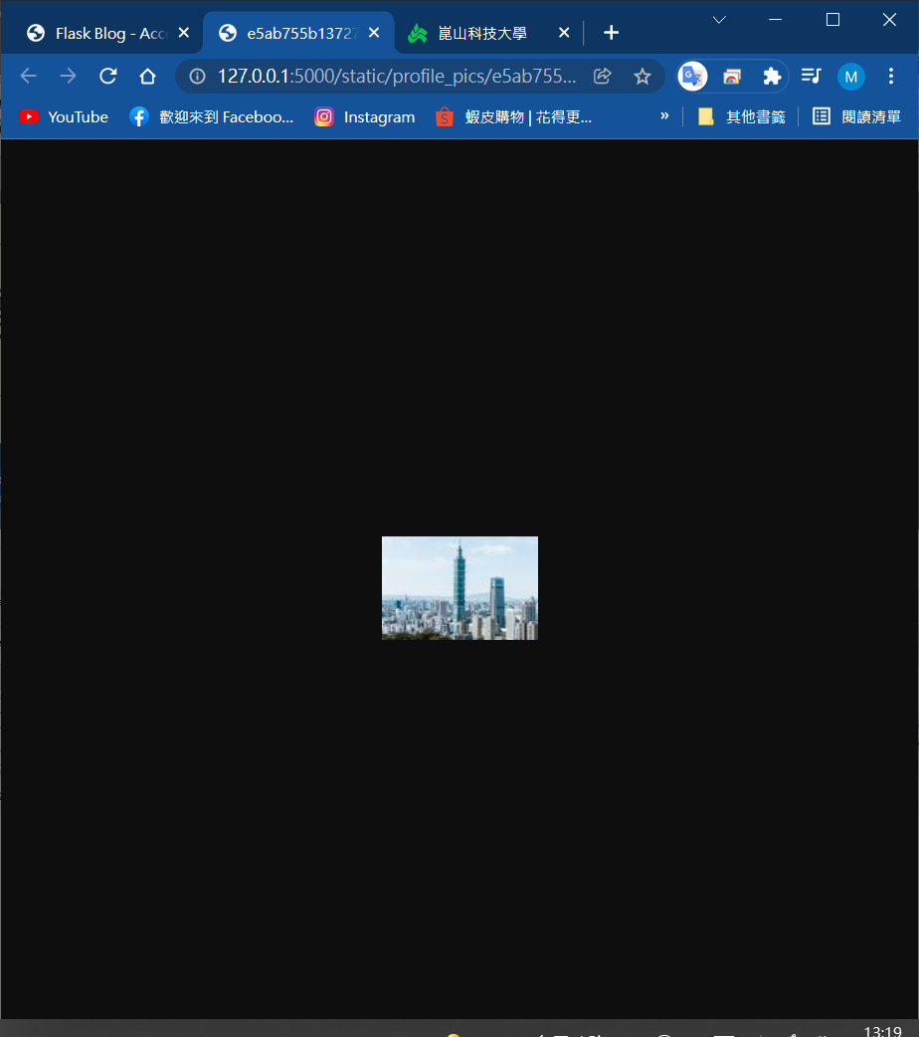
壓縮

Slide 12
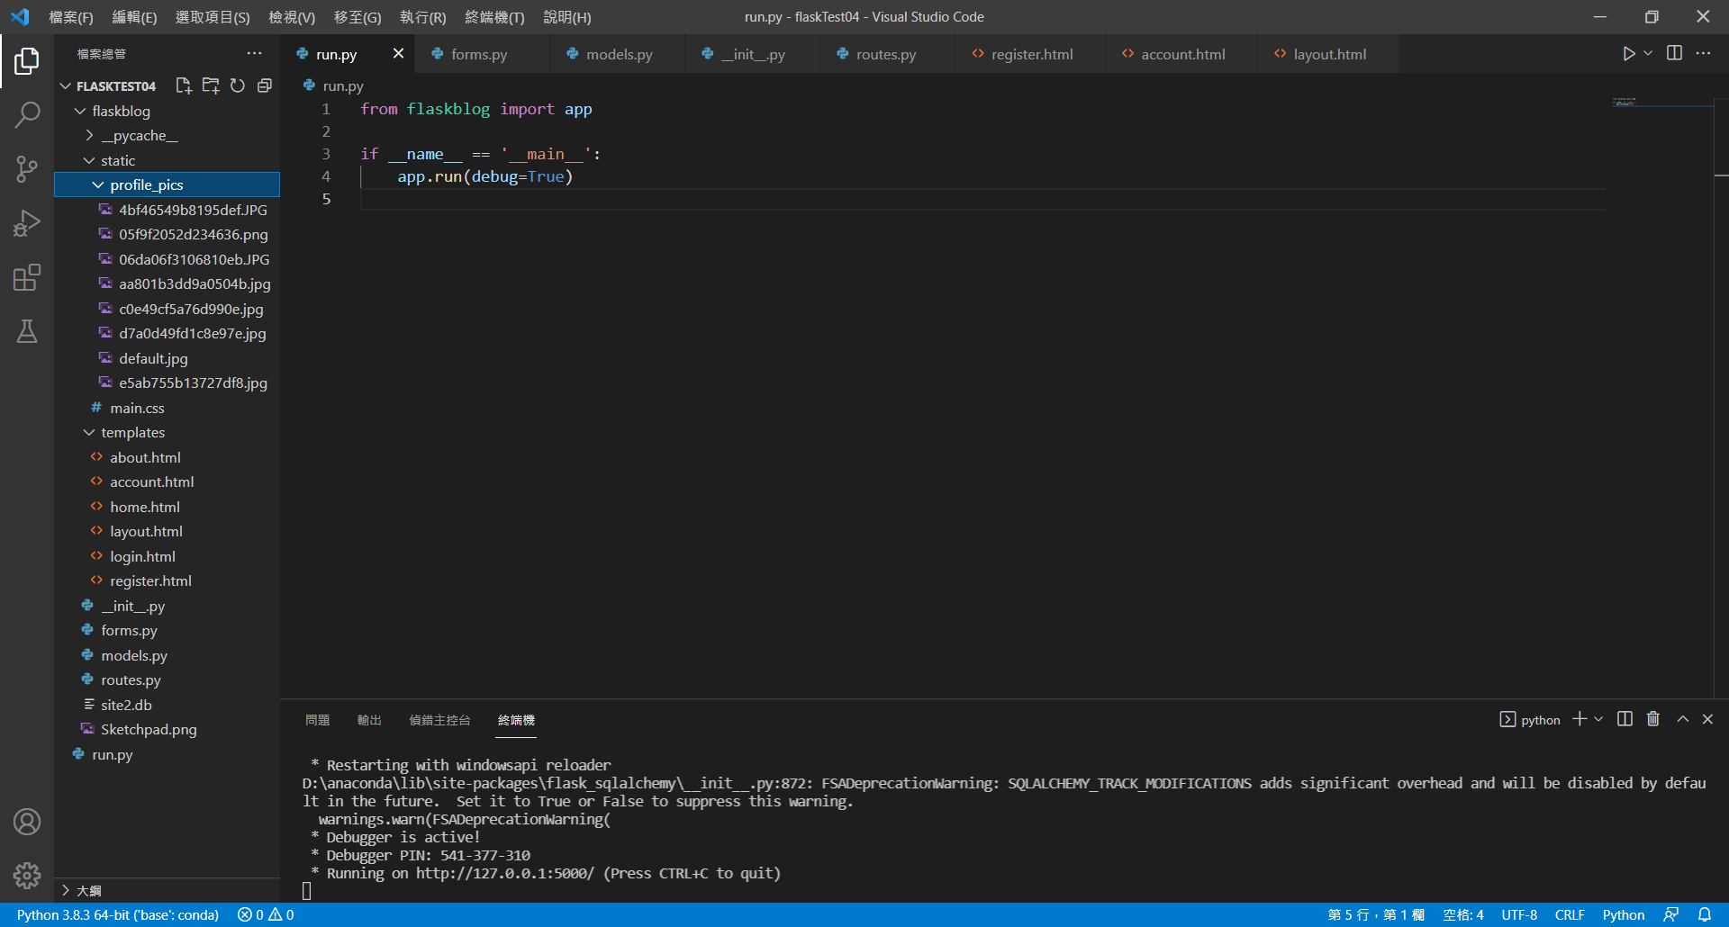
run.py

Slide 13
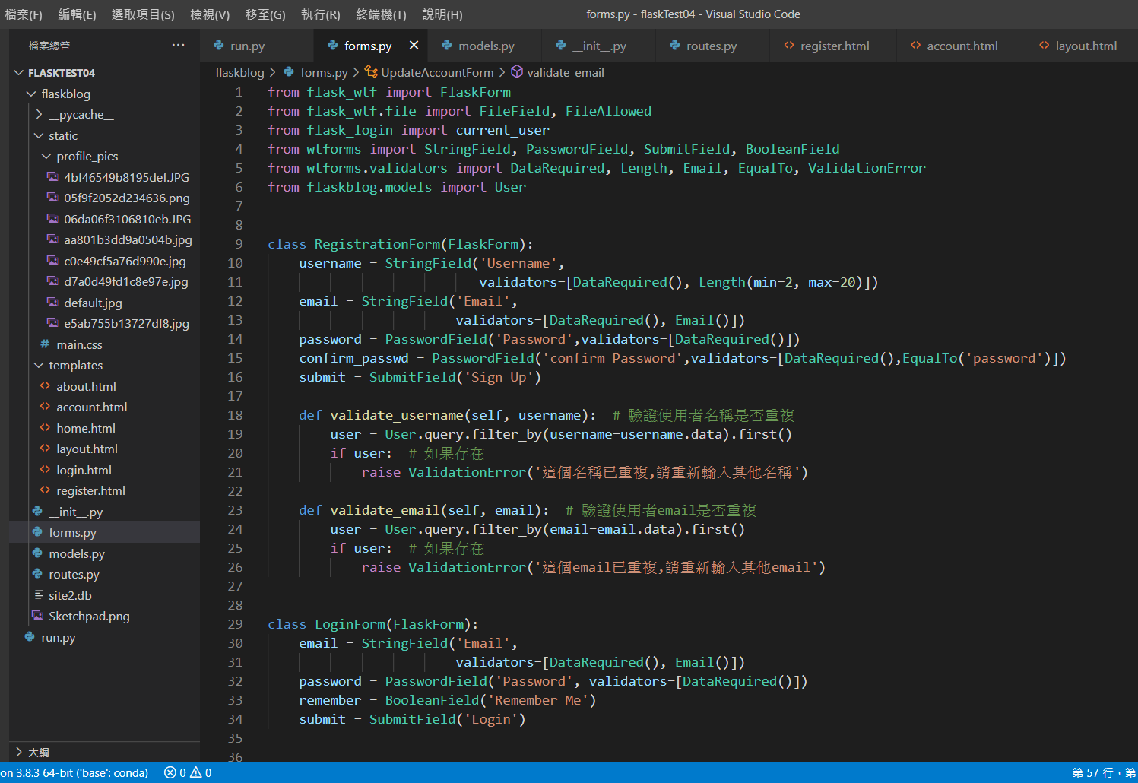
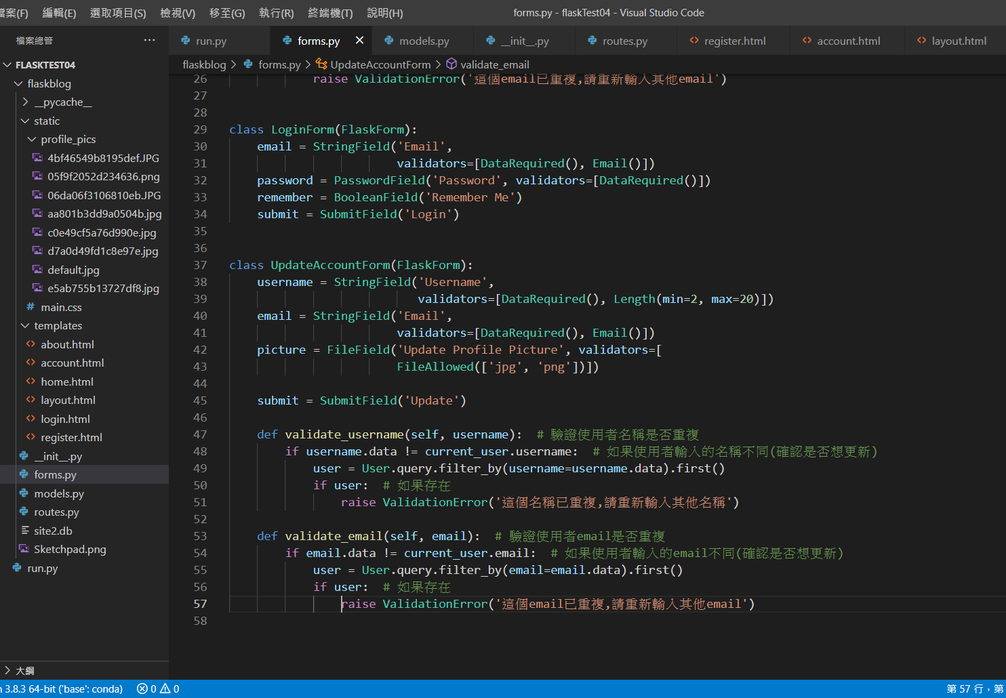
forms.py

Slide 14
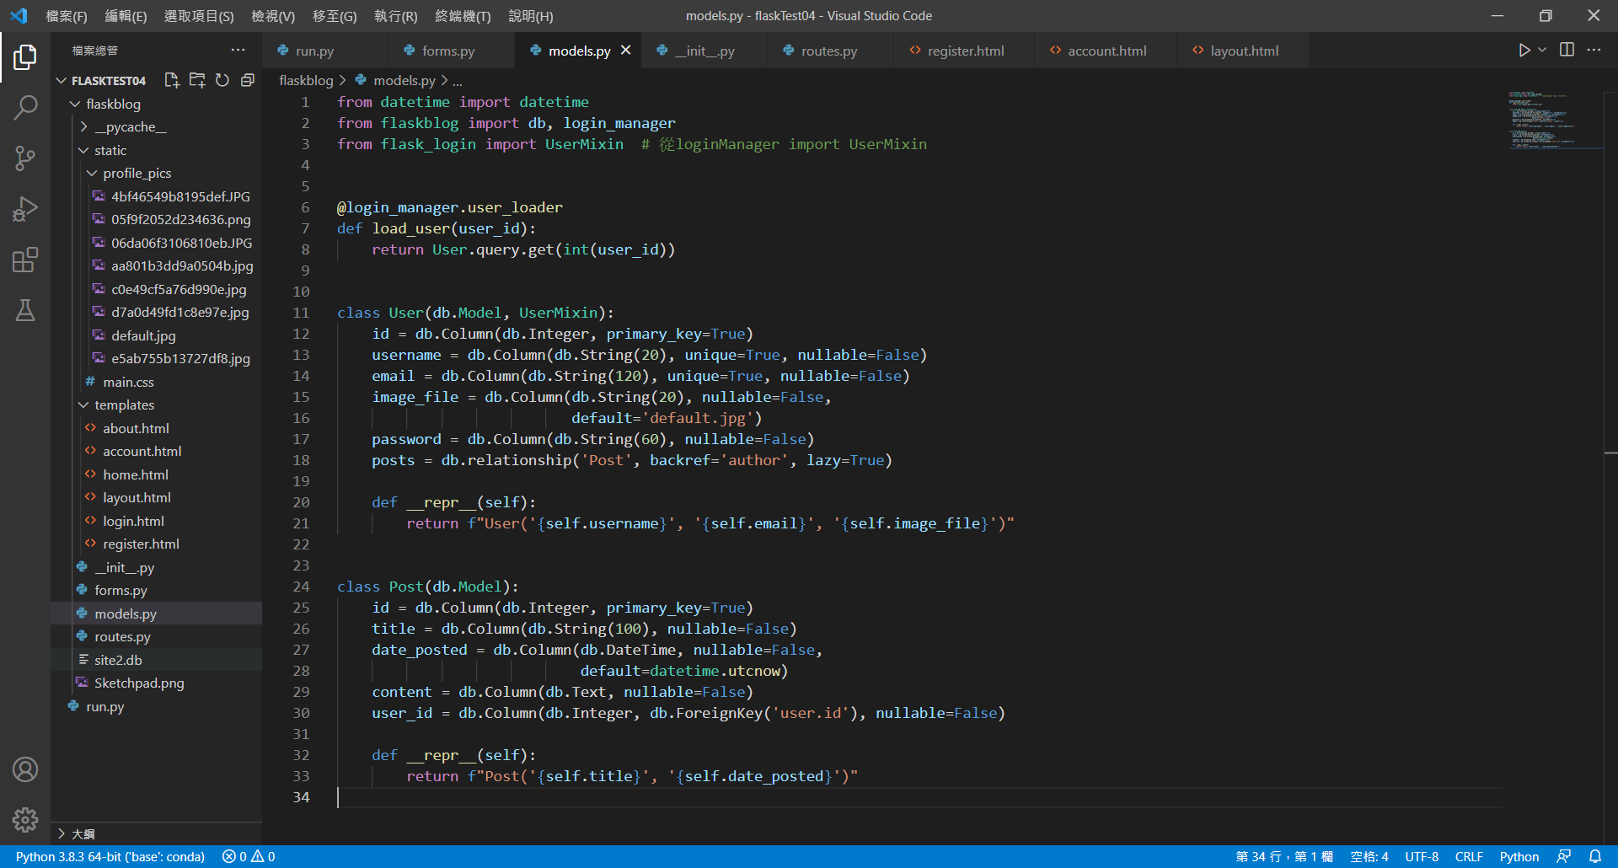
models.py

Slide 15
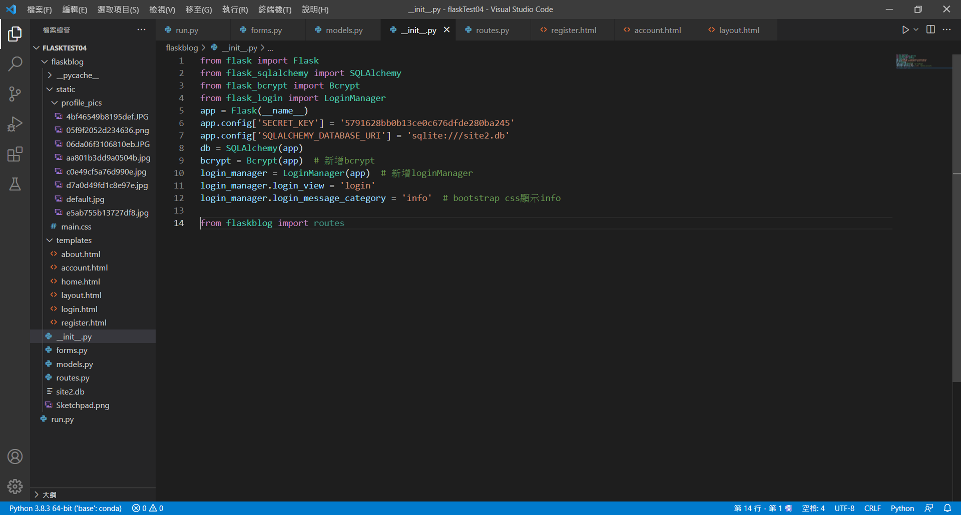
__init__.py

Slide 16
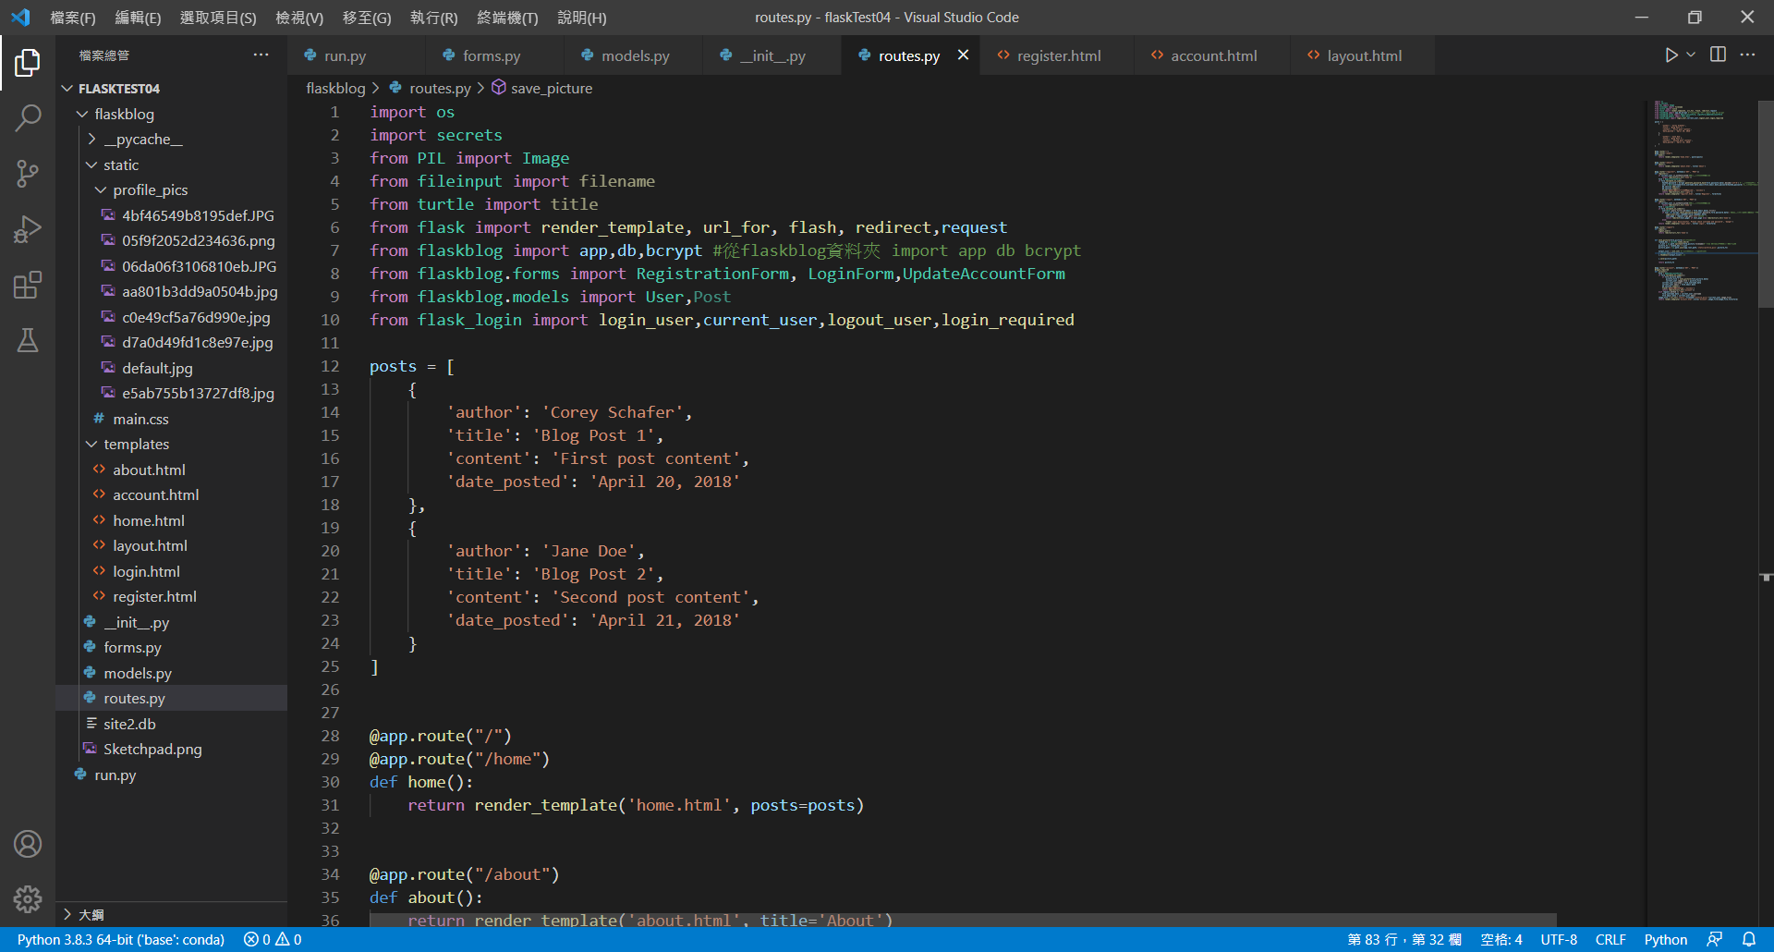
routes.py-1

Slide 17
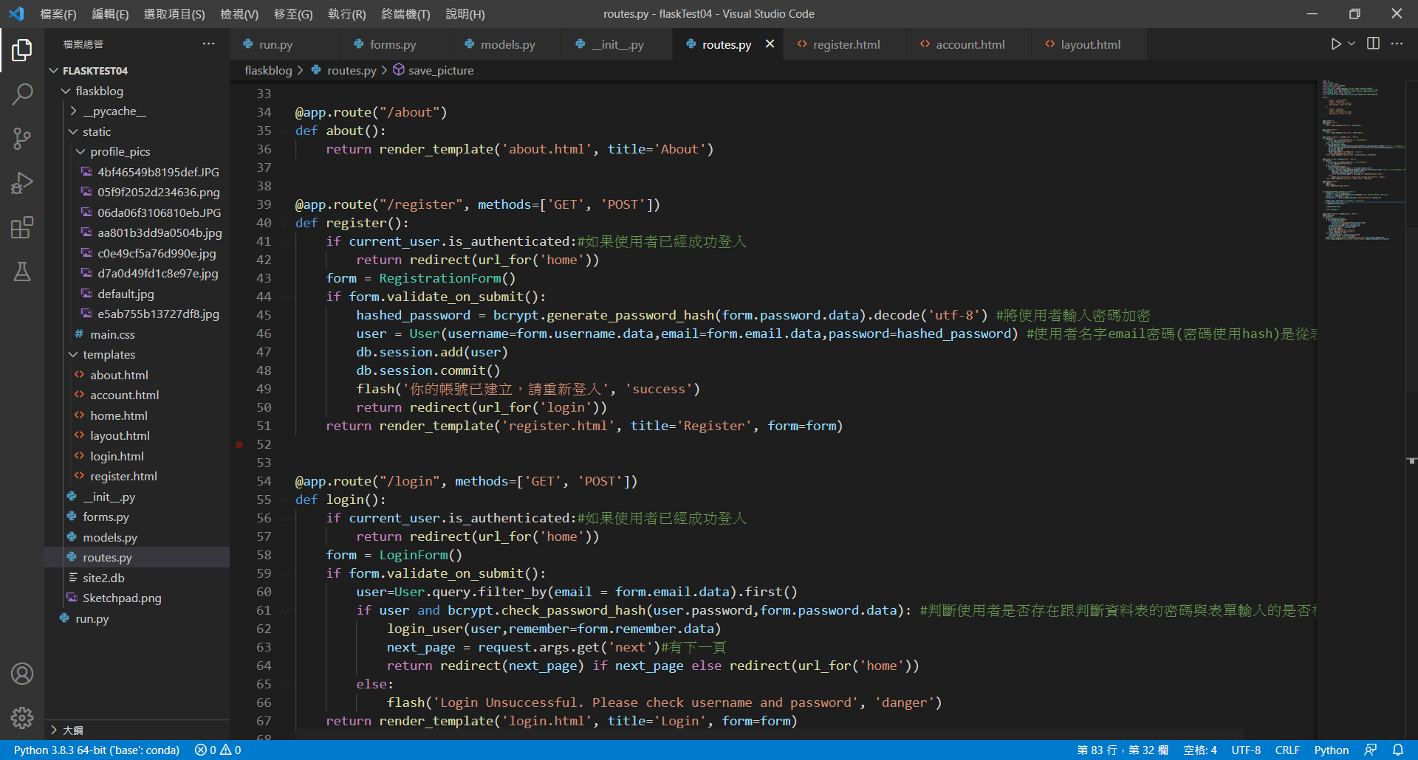
routes.py-2

Slide 18
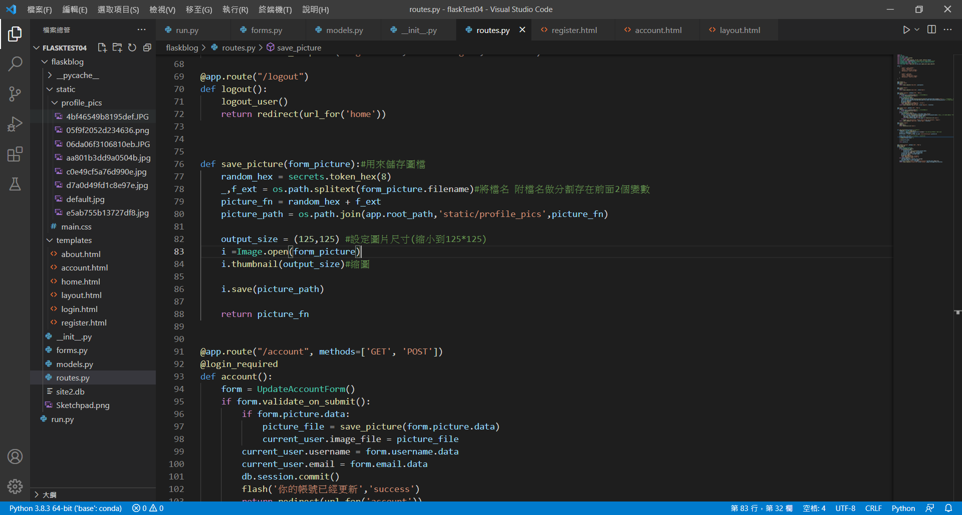
routes.py-3

Slide 19
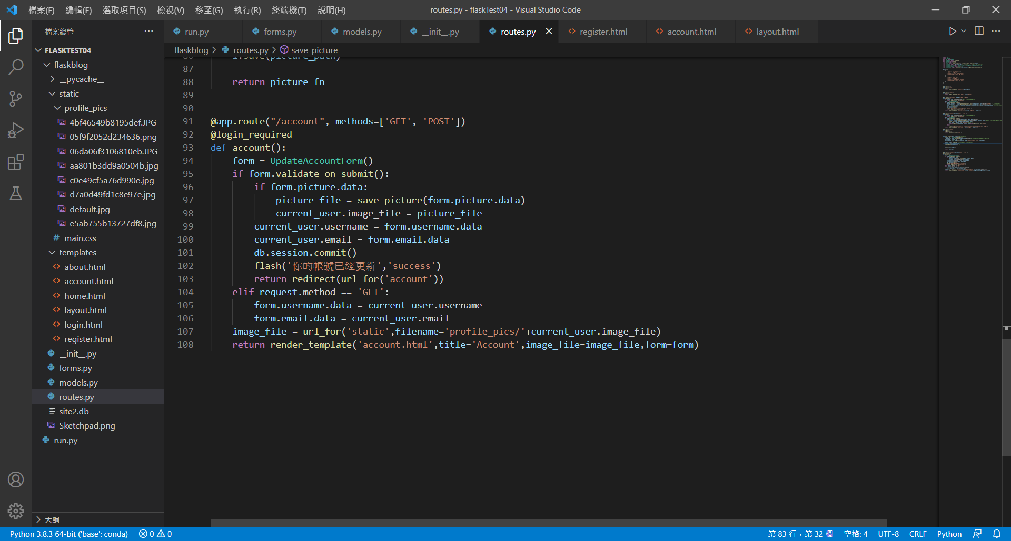
routes.py-4

Slide 20
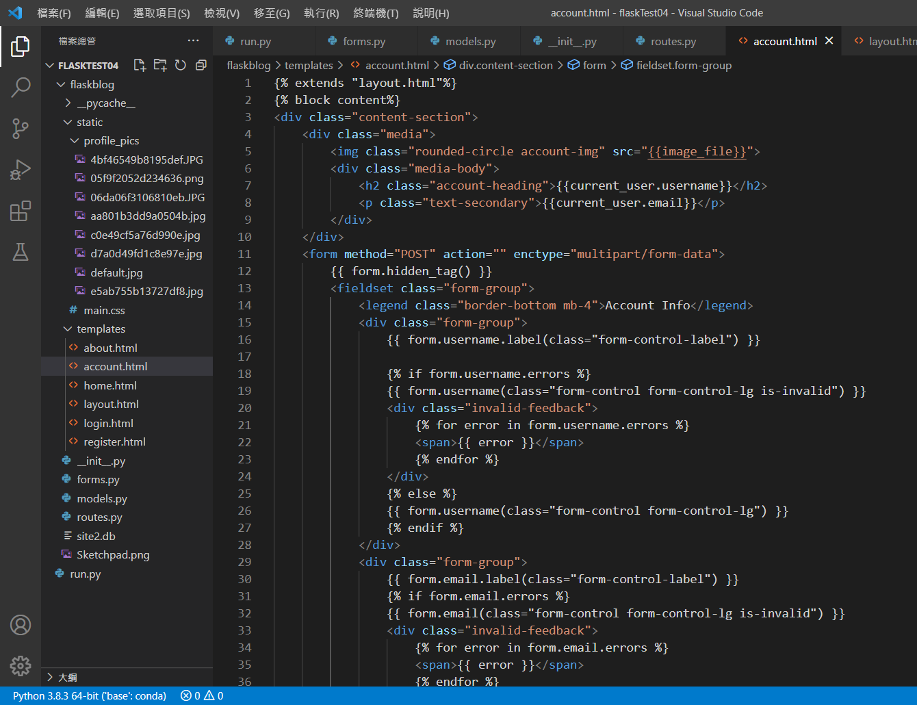
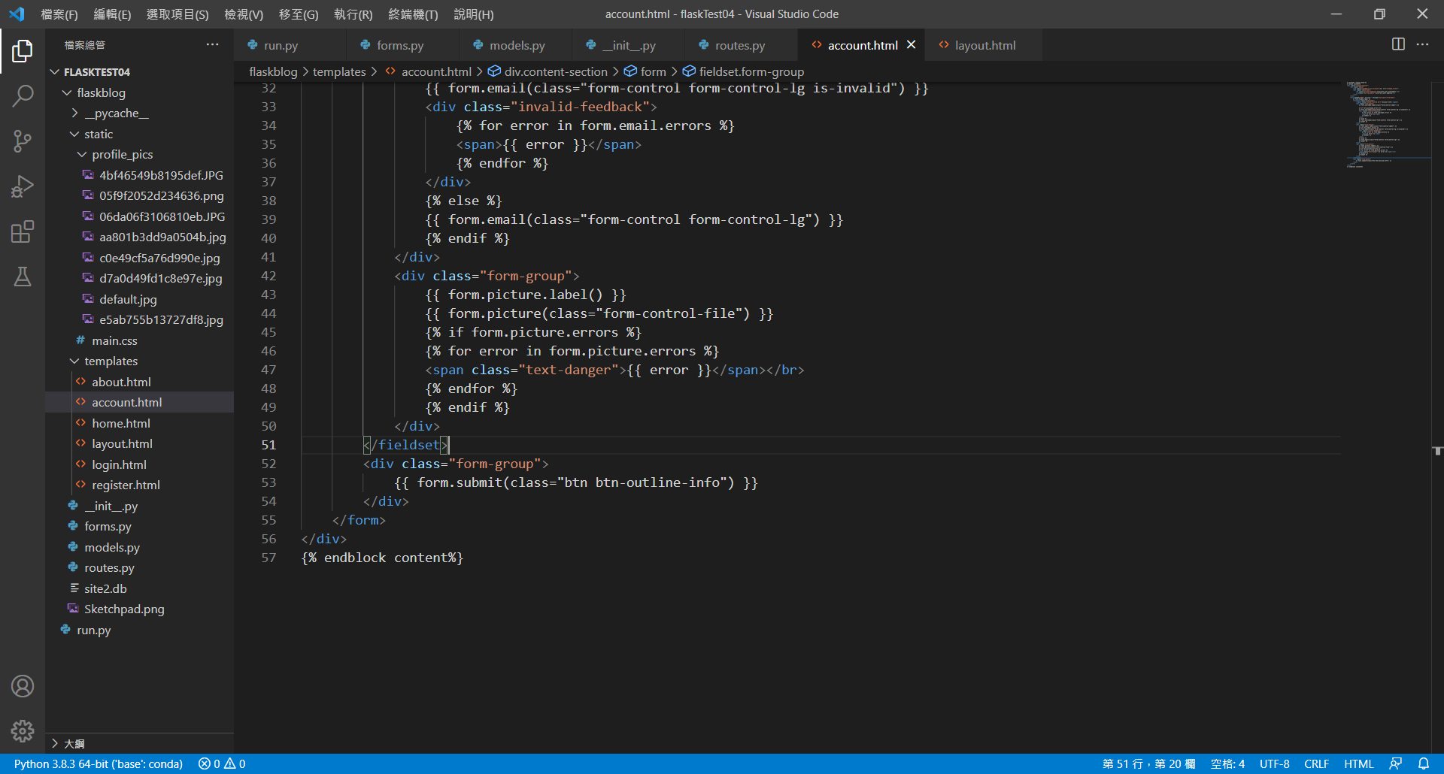
account.html

